Slide 1
California’s Healthcare Finance Analysis Presentation
Project Members :-
Deepanshu Badge
Prafull Nimje
Prafulla Wankhede
Nikhil Rahate
Priyanka Bahekar
Swaranjali Sontakke
Pranav Sherkar

Slide 2
Project analysis slide 2
Project Details
Objective :- To analyse Hospital Quarterly Financial and Utilization Report of California Healthcare from 2017 – 2020.
Tools Used :- MS- Excel, Power BI
KPI Used :-
Hospital Category
Bed Category
Total Operating Expenses
Total Gross Revenue
Total Net Revenue by year
Capital Premium Revenue by Year
Outpatients Revenue by year

Slide 3
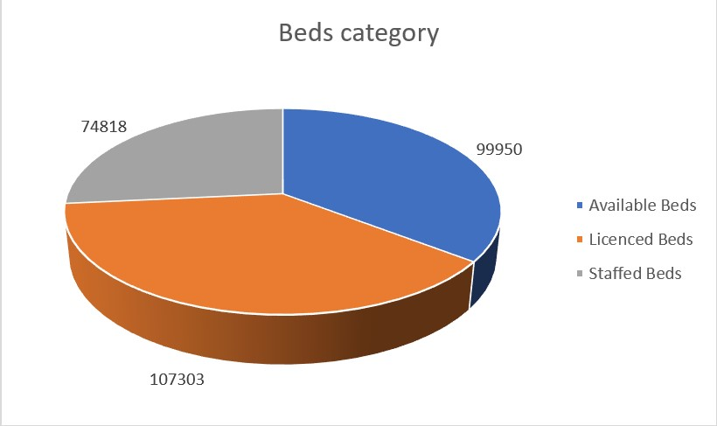
Project analysis slide 5
Project KPI’s
Beds Category | 2017 | 2018 | 2019 | 2020 | Grand Total
Available Beds | 99950 | 99521 | 93010 | 89139 | 381620
Licenced Beds | 107303 | 106976 | 100673 | 97159 | 412111
Staffed Beds | 74818 | 76657 | 71532 | 70395 | 293402
Hospital Bed Category
This KPI shows the categories of Beds available.
Table shows count of different types of beds available in the hospitals.
From the Pie chart we can insight that availability of Licenced beds is greater than Available beds and Staffed beds.

Slide 4
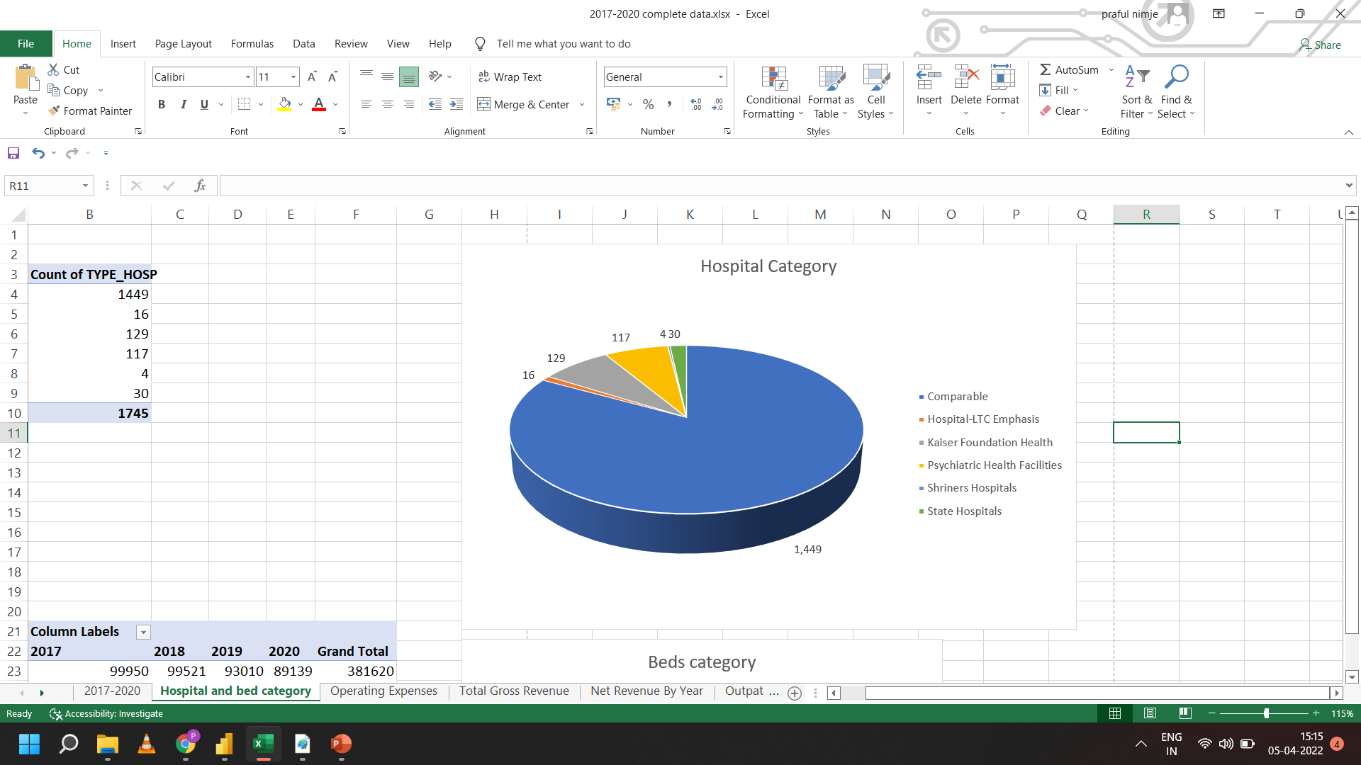
Project analysis slide 5
Project KPI’s
Hospital Category | Count of TYPE_HOSP
Comparable | 1449
Hospital-LTC Emphasis | 16
Kaiser Foundation Health | 129
Psychiatric Health Facilities | 117
Shriners Hospitals | 4
State Hospitals | 30
Grand Total | 1745
Hospital Category
This KPI we have used to describe categories of hospitals.
Table shows count of different types of hospital facilities available in the cities.
From the Pie chart we can insight that availability of comparable facilities is greatest and LTC Emphasis is the least.

Slide 5
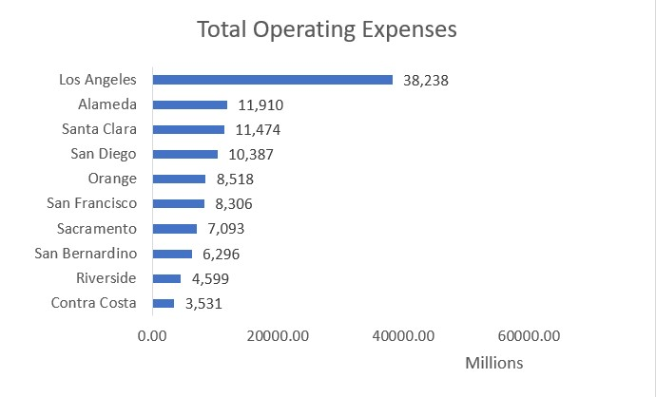
Project analysis slide 5
Project KPI’s
County Names | Total Operating Expenses
Contra Costa | 3530762777.00
Riverside | 4598968766.00
San Bernardino | 6295787754.00
Sacramento | 7092521418.00
San Francisco | 8305928643.00
Orange | 8518254058.00
San Diego | 10387451872.00
Santa Clara | 11474091405.00
Alameda | 11910071959.00
Los Angeles | 38238051158.00
Grand Total | 110351889810.00
Total Operating Expenses
This KPI shows the total operating expenses for the hospital.
Table shows operating expenses done by the hospitals in the different cities.
Bar chart shows that Los Angeles Health Department have highest expense than other cities.

Slide 6
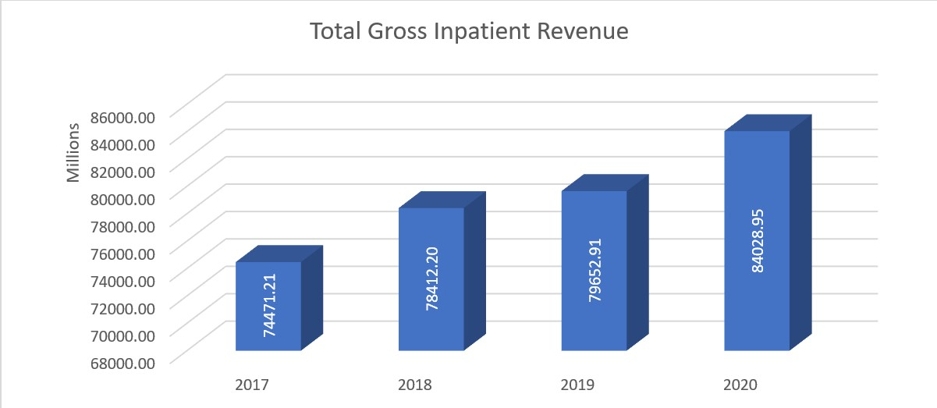
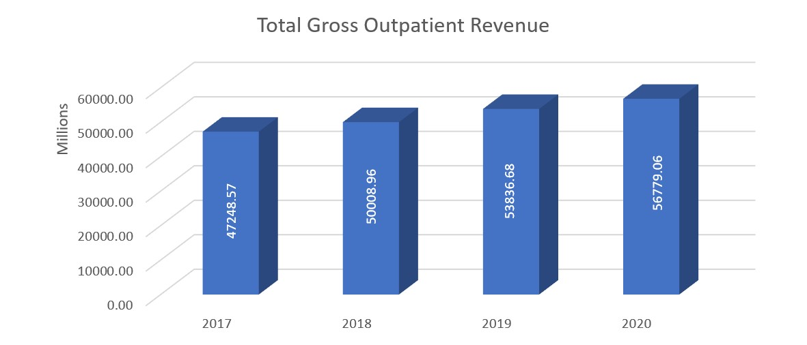
Project analysis slide 5
Project KPI’s
Total Gross Revenue from Inpatient and Outpatient
The two bar plots shows the total gross revenue collected from Inpatient and Outpatient respectively.
Total Gross Outpatient Revenue is greater the Total Gross Inpatient Revenue.

Slide 7
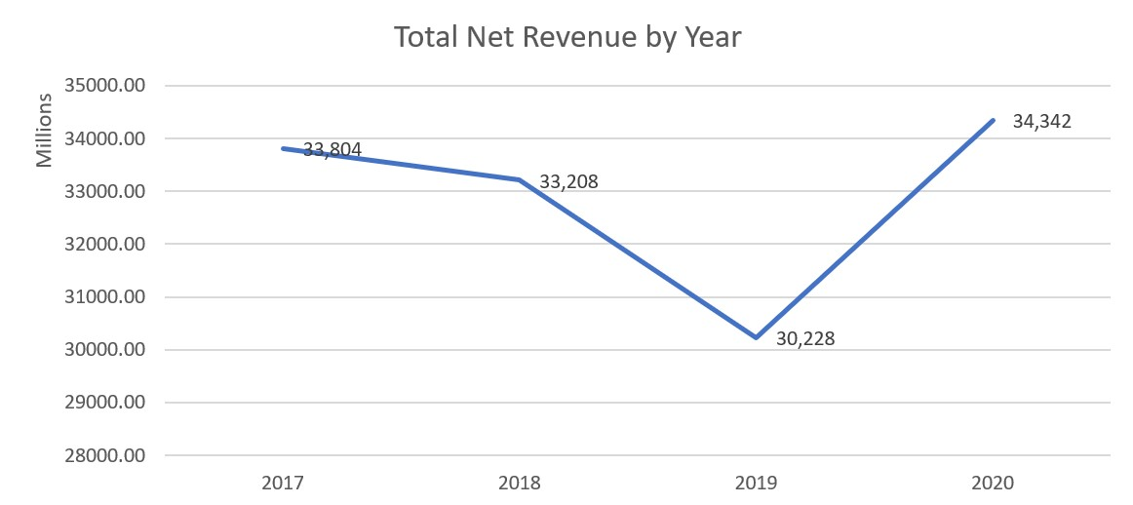
Project analysis slide 5
Project KPI’s
Year | Total Net Revenue by Year
2017 | $ 33,80,43,82,174.00
2018 | $ 33,20,75,12,328.00
2019 | $ 30,22,84,03,316.00
2020 | $ 34,34,23,85,478.00
Grand Total | $ 1,31,58,26,83,296.00
Total Net Revenue by Year
The line chart show Total Net Revenue from Hospitals from year 2017 - 2020.
We can make insight from line graph that from year 2017 to 2018, Net revenue has gradually dropped and drastic one from 2018 - 2019.
But from 2019 – 2020 we can see successive growth in Total Net Revenue with 4 Million dollars.

Slide 8
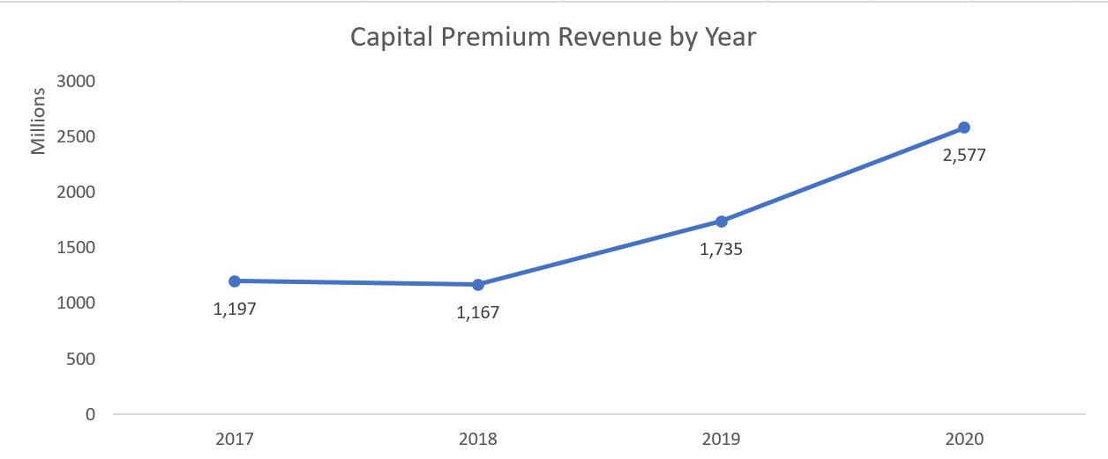
Project analysis slide 5
Project KPI’s
Year | Capital Premium Revenue
2017 | $ 1,19,74,63,634.00
2018 | $ 1,16,66,86,172.00
2019 | $ 1,73,50,97,094.00
2020 | $ 2,57,71,93,785.00
Grand Total | $ 6,67,64,40,685.00
Capital Premium Revenue by Year
The line chart show Capital Premium Revenue from Hospitals from year 2017 - 2020.
We can make insight from line graph that from year 2017 to 2020, Capital Premium Revenue has gradually increased over the period.

Slide 9
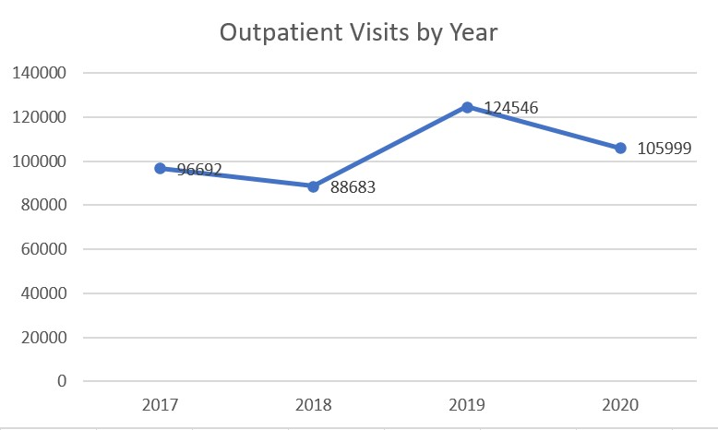
Project analysis slide 5
Project KPI’s
Year | Outpatient Visit
2017 | 96692
2018 | 88683
2019 | 124546
2020 | 105999
Grand Total | 415920
Outpatient Visits by Year
The line chart show Outpatient Visits to Hospitals from year 2017 - 2020.
We can make insight that in 2019, Outpatient Visits is greatest of all years.

Slide 10
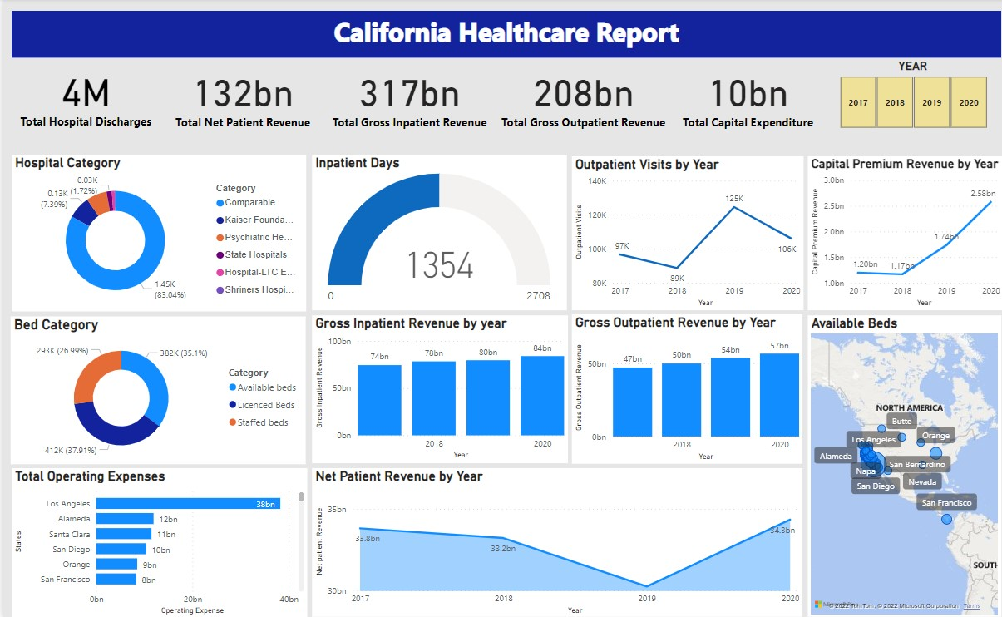
Power BI Dashboard

Slide 11
Thank You

